Slide 1
Preliminaries of Patter Recognition
K. Ramachandra Murthy
Email: k.ramachandra@isical.ac.in

Slide 2
Course Overview
Preliminaries (2 classes)
Introduction to Pattern Recognition (1 class)
Clustering (3 classes)
Dimensionality Reduction
  Feature Selection (2 classes)
  Feature Extraction (2 classes)
– Home work (One Week)
– Assignments (Two Weeks)

Slide 3
Overview
Linear Algebra
Statistics
Pattern Recognition
  Patterns and Features
  Class information
  Classification
  Clustering
  Dimensionality Reduction

Slide 4
Linear Algebra
Linear Algebra has become as basic and as applicable
as calculus, and fortunately it is easier.
--Gilbert Strang, MIT

Slide 5


Scalar
A quantity (variable), described by a single real number.
Eg. 24, -98.5, 0.7,….
e.g. Intensity of each digital Image
A pixel

Slide 6
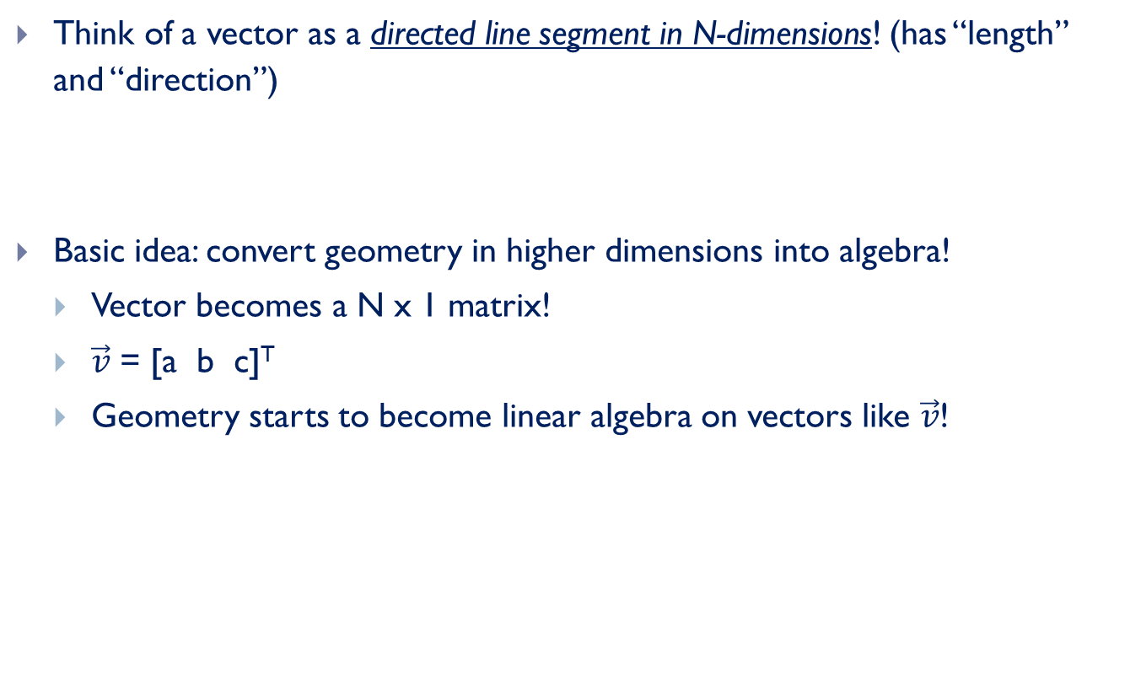


What is a Vector ?
Think of a vector as a directed line segment in N-dimensions! (has “length” and “direction”)
Basic idea: convert geometry in higher dimensions into algebra!
  Vector becomes a N x 1 matrix!
  $\vec{v}$ = [a b c]^{T}
  Geometry starts to become linear algebra on vectors like $\vec{v}$!
$$\vec{v}=\left[\begin{matrix}a \\ b \\ c\end{matrix}\right]$$
Vector means a column vector
y
$$\vec{v}$$
x

Slide 7
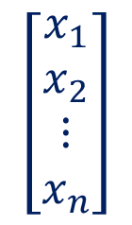
Vector
EXAMPLE:
$$\left[\begin{matrix}\begin{matrix}x_{1} \\ x_{2}\end{matrix} \\ ⋮ \\ x_{n}\end{matrix}\right]$$
VECTOR=
i.e. A column of numbers

Slide 8
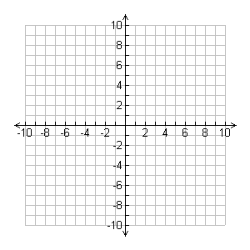

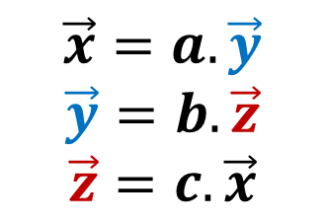


Parallel Vectors
Direction is same but length may vary
$$\vec{y}$$
$$\vec{x}$$
$$\vec{x}=a.\vec{y}$$
$$\vec{y}=b.\vec{z}$$
$$\vec{z}=c.\vec{x}$$
$$\vec{z}$$

Slide 9

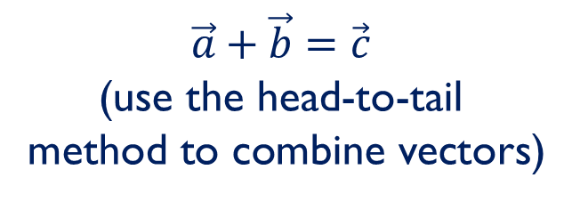




Vector Addition
$$\vec{a}+\vec{b}=\left(x_{1},x_{2}\right)+\left(y_{1},y_{2}\right)=\left(x_{1}+y_{1},x_{2}+y_{2}\right)$$
$$\vec{b}$$
$$\vec{a}+\vec{b}=\vec{c}$$
(use the head-to-tail method to combine vectors)
$$\vec{a}$$
$$\vec{c}$$
$$\vec{a}$$
$$\vec{b}$$

Slide 10






Vector Subtraction
$$\vec{a}−\vec{b}=\left(x_{1},x_{2}\right)−\left(y_{1},y_{2}\right)=\left(x_{1}−y_{1},x_{2}−y_{2}\right)$$
$$\vec{b}$$
$\vec{c}$= $\vec{a}+\vec{b}$
$\vec{d}$=$\vec{a}−\vec{b}$
$$\vec{a}$$
$$\vec{a}$$
$$\vec{b}$$

Slide 11

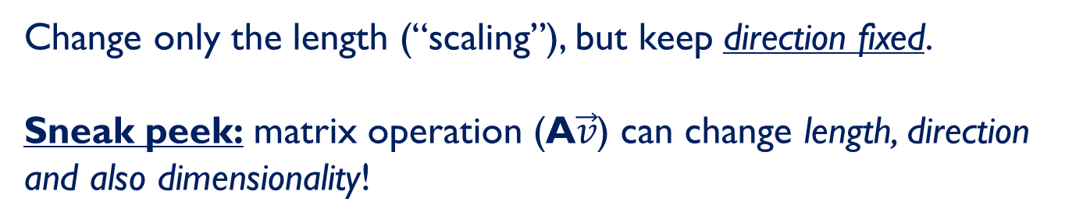





Scalar Product
$$a.\vec{v}=a.\left(x_{1},x_{2}\right)=\left(a.x_{1},a.x_{2}\right); a is scalr$$
$$a.\vec{v}$$
2$.\vec{v}$
$$\vec{v}$$
$$\vec{v}$$
$$\vec{v}$$
-$\vec{v}$
Change only the length (“scaling”), but keep direction fixed.
Sneak peek: matrix operation (A$\vec{v}$) can change length, direction and also dimensionality!
Notes:
A scalar is just a number, no direction included.
So scalar product does not change direction.

Slide 12
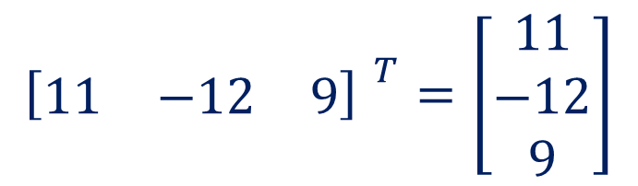
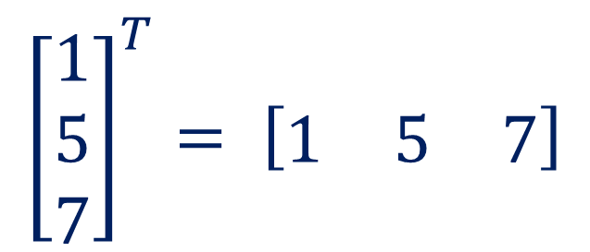
Transpose of a Vector
$${\left[\begin{matrix}1 \\ 5 \\ 7\end{matrix}\right]}^{T}= \left[\begin{matrix}1 & 5 & 7\end{matrix}\right]$$
$${\left[\begin{matrix}11 & −12 & 9\end{matrix}\right] }^{T}=\left[\begin{matrix}11 \\ −12 \\ 9\end{matrix}\right]$$

Slide 13
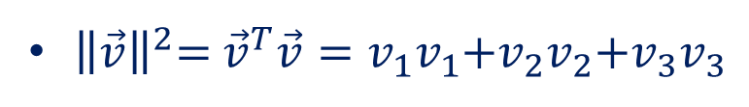
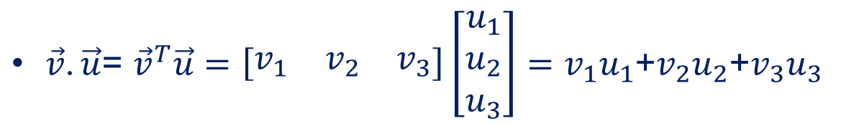
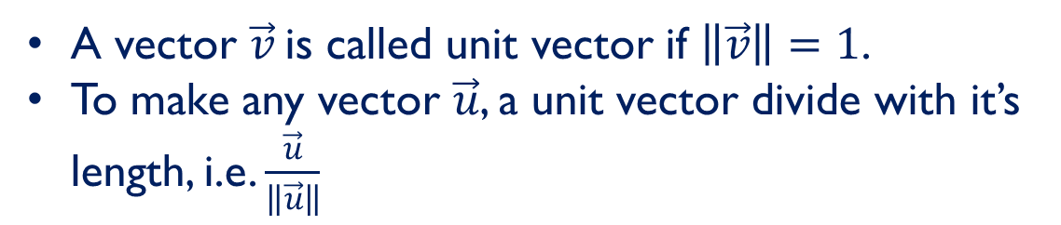
Vectors: Dot/Inner Product
$\vec{v}$. $\vec{u}$= ${\vec{v}}^{T}\vec{u}=\left[\begin{matrix}v_{1} & v_{2} & v_{3}\end{matrix}\right]\left[\begin{matrix}u_{1} \\ u_{2} \\ u_{3}\end{matrix}\right]=v_{1}u_{1}$+$v_{2}u_{2}$+$v_{3}u_{3}$
The inner product is a SCALAR!
${\left\|\vec{v}\right\|}^{2}$= ${\vec{v}}^{T}\vec{v}=v_{1}v_{1}$+$v_{2}v_{2}$+$v_{3}v_{3}$
The length is the dot product of a vector with itself
A vector $\vec{v}$is called unit vector if $\left\|\vec{v}\right\|=1$.
To make any vector $\vec{u}$, a unit vector divide with it’s length, i.e. $\frac{\vec{u}}{\left\|\vec{u}\right\|}$

Slide 14


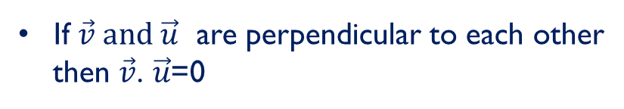
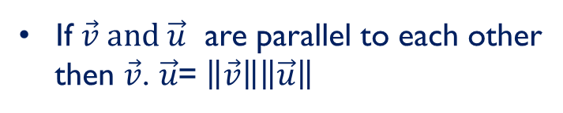











Vectors: Dot/Inner Product
The dot product is also related to the angle between the two vectors
$$\vec{v}$$
$\vec{v}$. $\vec{u}$= $\left\|\vec{v}\right\|\left\|\vec{u}\right\|$ cos$θ$
$$θ$$
$⟹$ cos$θ=\frac{\vec{v}\text{. }\vec{u}}{\left\|\vec{v}\right\|\left\|\vec{u}\right\|}$
$$\vec{u}$$
If $\vec{v} and \vec{u}$ are perpendicular to each other
then $\vec{v}\text{. }\vec{u}$=0
$$\vec{v}$$
cos$\text{90}\text{o}=\frac{\vec{v}\text{. }\vec{u}}{\left\|\vec{v}\right\|\left\|\vec{u}\right\|}$
90º
$$\vec{u}$$
$$⟹\vec{v}\text{. }\vec{u}=0$$
180º
If $\vec{v} and \vec{u}$ are parallel to each other
then $\vec{v}\text{. }\vec{u}$= $\left\|\vec{v}\right\|\left\|\vec{u}\right\|$
$$\vec{v}$$
$$\vec{u}$$
0º
$$\vec{u}$$
$$\vec{v}$$

Slide 15
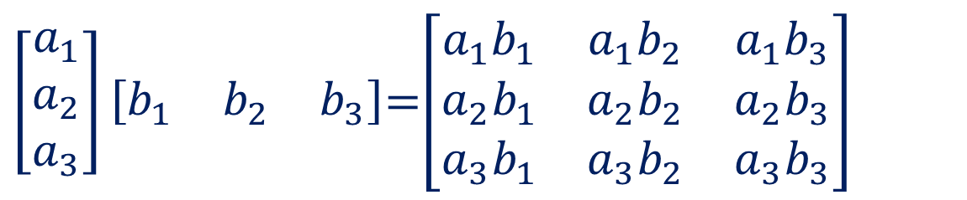
Outer Product
Outer product of two vectors is a matrix.
Simple matrix multiplication of vectors
$\left[\begin{matrix}a_{1} \\ a_{2} \\ a_{3}\end{matrix}\right]\left[\begin{matrix}b_{1} & b_{2} & b_{3}\end{matrix}\right]$=$\left[\begin{matrix}a_{1}b_{1} & a_{1}b_{2} & a_{1}b_{3} \\ a_{2}b_{1} & a_{2}b_{2} & a_{2}b_{3} \\ a_{3}b_{1} & a_{3}b_{2} & a_{3}b_{3}\end{matrix}\right]$

Slide 16
Linear Independence
Different direction vectors are independent.
Parallel vectors are dependent

Slide 17
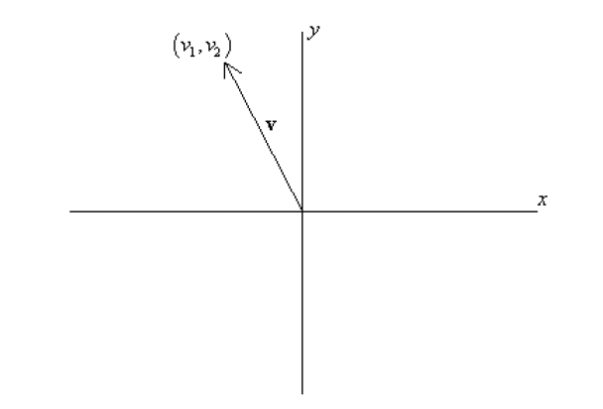
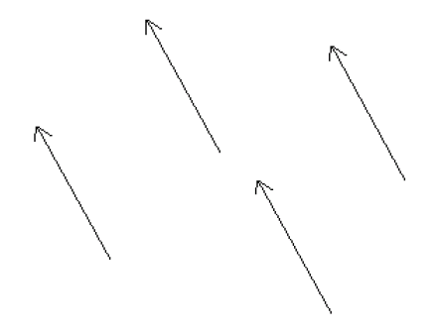
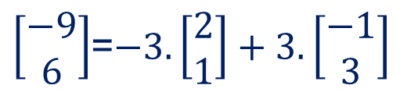
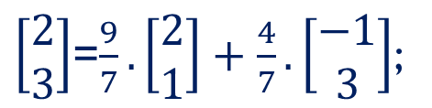
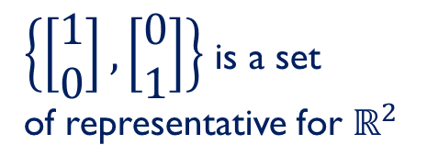
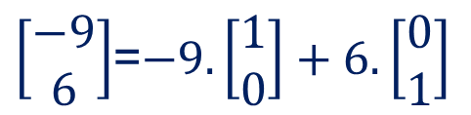

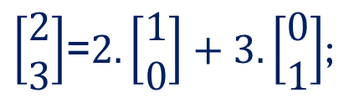
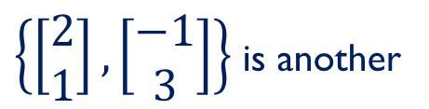
Basis & Orthonormal Bases
Basis (or axes): frame of reference
vs
Basis
$\left[\begin{matrix}2 \\ 3\end{matrix}\right]$=$2.\left[\begin{matrix}1 \\ 0\end{matrix}\right]+3.\left[\begin{matrix}0 \\ 1\end{matrix}\right]$;
$\left[\begin{matrix}−9 \\ 6\end{matrix}\right]$=$−9.\left[\begin{matrix}1 \\ 0\end{matrix}\right]+6.\left[\begin{matrix}0 \\ 1\end{matrix}\right]$
$\left\{\left[\begin{matrix}1 \\ 0\end{matrix}\right],\left[\begin{matrix}0 \\ 1\end{matrix}\right]\right\}$ is a set
of representative for $ℝ^{2}$
$\left[\begin{matrix}2 \\ 3\end{matrix}\right]$=$\frac{9}{7}.\left[\begin{matrix}2 \\ 1\end{matrix}\right]+\frac{4}{7}.\left[\begin{matrix}−1 \\ 3\end{matrix}\right]$;
$\left[\begin{matrix}−9 \\ 6\end{matrix}\right]$=$−3.\left[\begin{matrix}2 \\ 1\end{matrix}\right]+3.\left[\begin{matrix}−1 \\ 3\end{matrix}\right]$
$\left\{\left[\begin{matrix}2 \\ 1\end{matrix}\right],\left[\begin{matrix}−1 \\ 3\end{matrix}\right]\right\}$ is another
Set of representative for $ℝ^{2}$

Slide 18
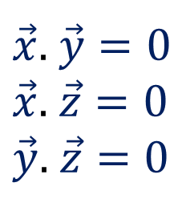
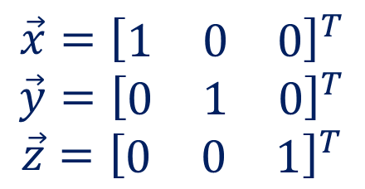
Basis & Orthonormal Bases
Basis: a space is totally defined by a set of vectors – any point is a linear combination of the basis
Ortho-Normal: orthogonal + normal
[Sneak peek: Orthogonal: dot product is zero
Normal: magnitude is one ]
$$\vec{x}={\left[\begin{matrix}1 & 0 & 0\end{matrix}\right]}^{T}$$
$$\vec{y}={\left[\begin{matrix}0 & 1 & 0\end{matrix}\right]}^{T}$$
$$\vec{z}={\left[\begin{matrix}0 & 0 & 1\end{matrix}\right]}^{T}$$
$\vec{x}$. $\vec{y}=0$
$\vec{x}$. $\vec{z}=0$
$\vec{y}$. $\vec{z}=0$

Slide 19
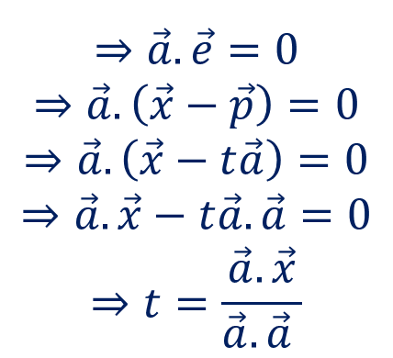

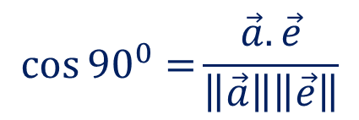




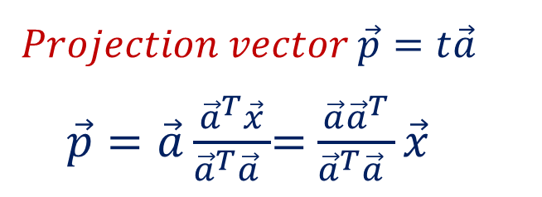
Projection: Using Inner Products
Projection of $\vec{x}$ along the direction $\vec{a}$
$$\cos{{90}^{0}=}\frac{\vec{a}.\vec{e}}{\left\|\vec{a}\right\|\left\|\vec{e}\right\|}$$
y
Light Source
$$⇒\vec{a}.\vec{e}=0$$
$$⇒\vec{a}.\left(\vec{x}−\vec{p}\right)=0$$
$$⇒\vec{a}.\left(\vec{x}−t\vec{a}\right)=0$$
$$⇒\vec{a}.\vec{x}−t\vec{a}.\vec{a}=0$$
$$⇒t=\frac{\vec{a}.\vec{x}}{\vec{a}.\vec{a} }$$
$$\vec{x}$$
$$\vec{e}=\vec{x}−\vec{p}$$
$$Projection vector \vec{p}=t\vec{a}$$
$\vec{p}=\vec{a}\frac{{\vec{a}}^{T}\vec{x}}{{\vec{a}}^{T}\vec{a} }$= $\frac{\vec{a}{\vec{a}}^{T}}{{\vec{a}}^{T}\vec{a} }\vec{x}$
$$\vec{a}$$
x
$$\vec{p}=t\vec{a}$$
Projection Matrix

Slide 20
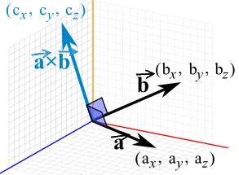
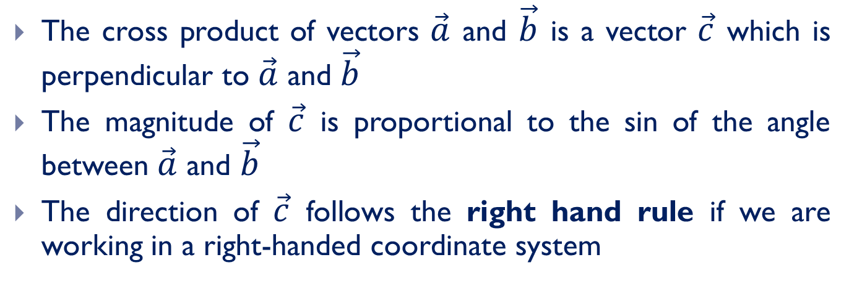
Vectors: Cross Product
The cross product of vectors $\vec{a}$ and $\vec{b}$ is a vector $\vec{c}$ which is perpendicular to $\vec{a}$ and $\vec{b}$
The magnitude of $\vec{c}$ is proportional to the sin of the angle between $\vec{a}$ and $\vec{b}$
The direction of $\vec{c}$ follows the right hand rule if we are working in a right-handed coordinate system

Slide 21
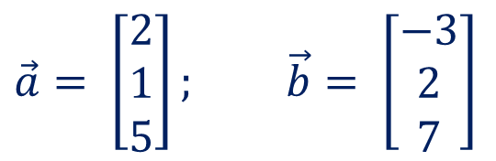

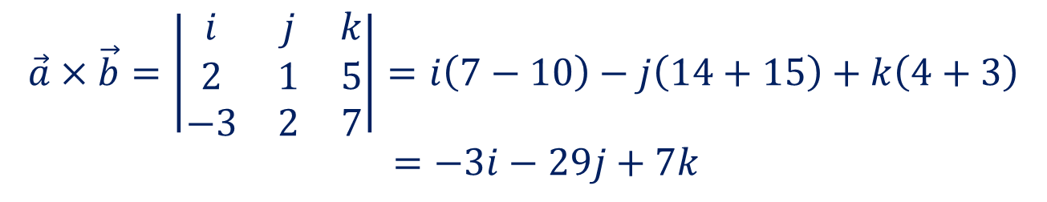
MAGNITUDE OF THE CROSS PRODUCT
$$\left\|A×B\right\|=\left\|A\right\| \left\|B\right\| \sin{θ}$$
Example:
$\vec{a}= \left[\begin{matrix}2 \\ 1 \\ 5\end{matrix}\right];$ $\vec{b}= \left[\begin{matrix}−3 \\ 2 \\ 7\end{matrix}\right]$
$$\vec{a}×\vec{b}=\left|\begin{matrix}i & j & k \\ 2 & 1 & 5 \\ −3 & 2 & 7\end{matrix}\right|=i\left(7−10\right)−j\left(14+15\right)+k\left(4+3\right)$$
$=−3i−29j+7k$

Slide 22

What is a Matrix?
A matrix is a set of elements, organized into rows and columns
rows
$$\left[\begin{matrix}a_{11} & a_{12} \\ a_{21} & a_{22}\end{matrix}\right]$$
columns

Slide 23
Example

Slide 24
Basic Matrix Operations
Addition, Subtraction, Multiplication: creating new matrices (or functions)
Just add elements
Just subtract elements
Multiply each row by each column
Note: Matrix multiplication is possible only when number of columns of first
matrix is equal to number of rows of second one.
Notes:
Addition and subtraction must be done in same dimension
Do multiplication together

Slide 25
Matrix Times Matrix

Slide 26
Multiplication
Is AB = BA? Maybe, but maybe not!
Heads up: multiplication is NOT commutative!

Slide 27
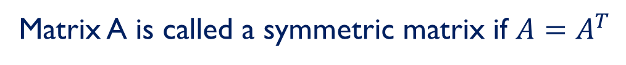
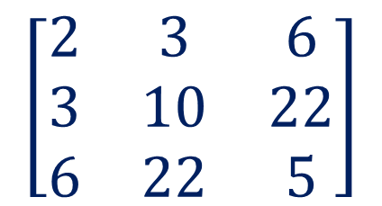
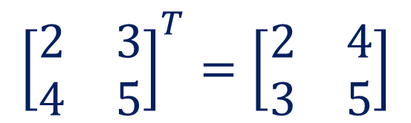
Transpose & Symmetric Matrix
Transpose of a matrix A is formed by turning all the rows of a given matrix into columns and vice-versa.
$${\left[\begin{matrix}2 & 3 \\ 4 & 5\end{matrix}\right]}^{T}=\left[\begin{matrix}2 & 4 \\ 3 & 5\end{matrix}\right]$$
Matrix A is called a symmetric matrix if $A=A^{T}$
$$\left[\begin{matrix}2 & 3 & 6 \\ 3 & 10 & 22 \\ 6 & 22 & 5\end{matrix}\right]$$

Slide 28
Matrix operating on vectors
Matrix is like a function that transforms the vectors on a plane
Matrix operating on a general point => transforms x- and y-components
System of linear equations: matrix is just the bunch of coeffs !
x' = a.x + b.y
y' = c.x + d.y
⎡
a
b
⎤
⎡
x
⎤
⎡
x
'
⎤
=
⎢
⎥
⎢
⎥
⎢
⎥
⎣
c
d
⎦
⎣
y
⎦
⎣
y
'
⎦

Slide 29
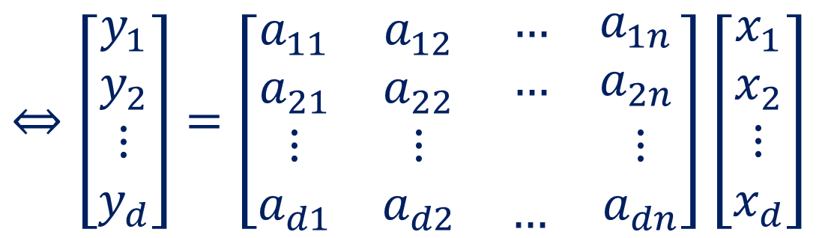
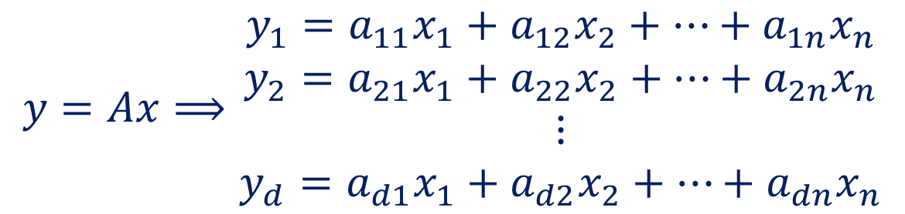
Linear Transformation
$$y=Ax⟹\begin{matrix}y_{1}=a_{11}x_{1}+a_{12}x_{2}+⋯+a_{1n}x_{n} \\ y_{2}=a_{21}x_{1}+a_{22}x_{2}+⋯+a_{2n}x_{n} \\ \begin{matrix}⋮ \\ y_{d}=a_{d1}x_{1}+a_{d2}x_{2}+⋯+a_{dn}x_{n}\end{matrix}\end{matrix}$$
$⇔\left[\begin{matrix}y_{1} \\ y_{2} \\ \begin{matrix}⋮ \\ y_{d}\end{matrix}\end{matrix}\right]=\left[\begin{matrix}a_{11} & a_{12} & \begin{matrix}… & a_{1n}\end{matrix} \\ a_{21} & a_{22} & \begin{matrix}… & a_{2n}\end{matrix} \\ \begin{matrix}⋮ \\ a_{d1}\end{matrix} & \begin{matrix}⋮ \\ a_{d2}\end{matrix} & \begin{matrix}\begin{matrix} \\ …\end{matrix} & \begin{matrix}⋮ \\ a_{dn}\end{matrix}\end{matrix}\end{matrix}\right]$ $\left[\begin{matrix}x_{1} \\ x_{2} \\ \begin{matrix}⋮ \\ x_{d}\end{matrix}\end{matrix}\right]$

Slide 30
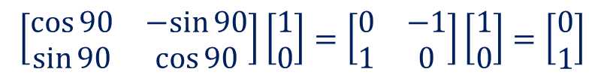
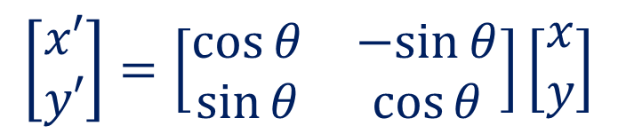
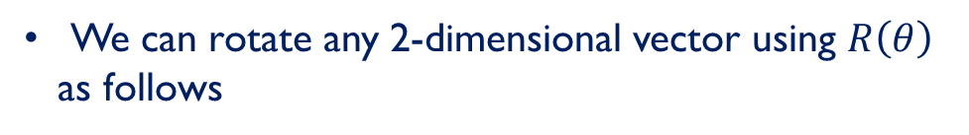
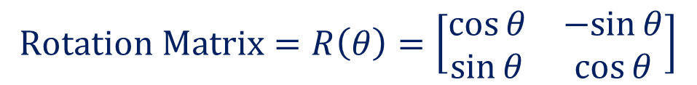


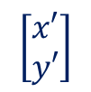



Rotation
$$Rotation Matrix=R\left(θ\right)=\left[\begin{matrix}\cos{θ} & −sin{θ} \\ \sin{θ} & \cos{θ}\end{matrix}\right]$$
$$\left[\begin{matrix}x′ \\ y′\end{matrix}\right]$$
We can rotate any 2-dimensional vector using $R\left(θ\right)$
as follows
$$\left[\begin{matrix}x′ \\ y′\end{matrix}\right]=\left[\begin{matrix}\cos{θ} & −sin{θ} \\ \sin{θ} & \cos{θ}\end{matrix}\right]\left[\begin{matrix}x \\ y\end{matrix}\right]$$
$$θ$$
$$\left[\begin{matrix}x \\ y\end{matrix}\right]$$
$$\left[\begin{matrix}0 \\ 1\end{matrix}\right]$$
Example :
$$\left[\begin{matrix}\cos{90} & −sin{90} \\ \sin{90} & \cos{90}\end{matrix}\right]\left[\begin{matrix}1 \\ 0\end{matrix}\right]=\left[\begin{matrix}0 & −1 \\ 1 & 0\end{matrix}\right]\left[\begin{matrix}1 \\ 0\end{matrix}\right]=\left[\begin{matrix}0 \\ 1\end{matrix}\right]$$
$${90}^{0}$$
$$\left[\begin{matrix}1 \\ 0\end{matrix}\right]$$

Slide 31
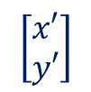



Rotation
y
$$\left[\begin{matrix}x′ \\ y′\end{matrix}\right]$$
$$\left[\begin{matrix}x \\ y\end{matrix}\right]$$
$$↶$$
$$θ$$
x

Slide 32
Rotation
P
P`

Slide 33
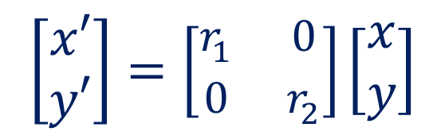
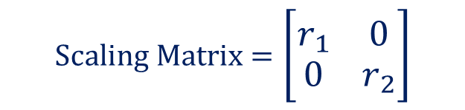
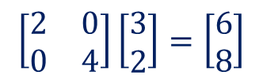
Scaling
$$Scaling Matrix=\left[\begin{matrix}r_{1} & 0 \\ 0 & r_{2}\end{matrix}\right]$$
We can scale any 2-dimensional vector as follows
$$\left[\begin{matrix}x′ \\ y′\end{matrix}\right]=\left[\begin{matrix}r_{1} & 0 \\ 0 & r_{2}\end{matrix}\right]\left[\begin{matrix}x \\ y\end{matrix}\right]$$
Example :
$$\left[\begin{matrix}2 & 0 \\ 0 & 4\end{matrix}\right]\left[\begin{matrix}3 \\ 2\end{matrix}\right]=\left[\begin{matrix}6 \\ 8\end{matrix}\right]$$

Slide 34
Scaling
r 0
0 r
a.k.a: dilation (r >1),
contraction (r <1)

Slide 35

Translation
$$P^{′}=\left[\begin{matrix}x \\ y\end{matrix}\right]+\left[\begin{matrix}t_{x} \\ t_{y}\end{matrix}\right]=P+t$$
P’
t
ty
P
y
x
tx

Slide 36
Translation
P’
P
t

Slide 37
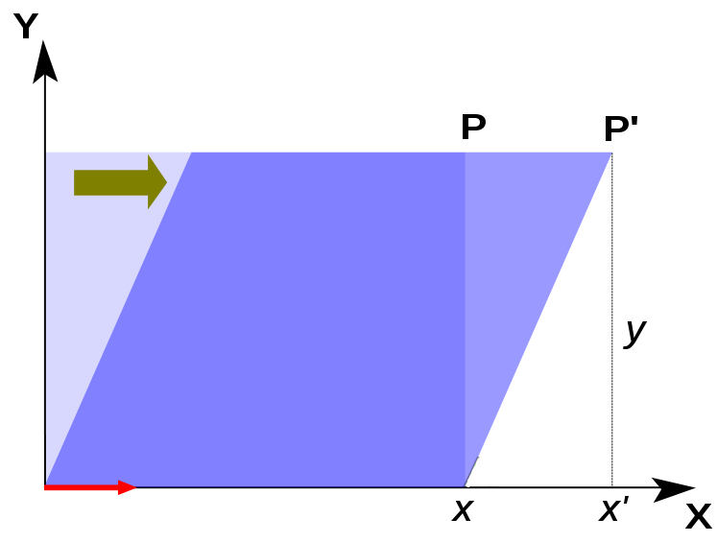
Shear
A transformation in which all points along a given line L remain fixed while other points are shifted parallel to L by a distance proportional to their perpendicular distance from L.
L

Slide 38
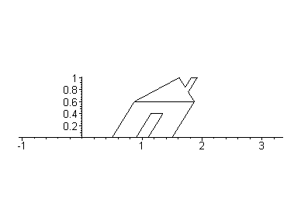
Shear

Slide 39
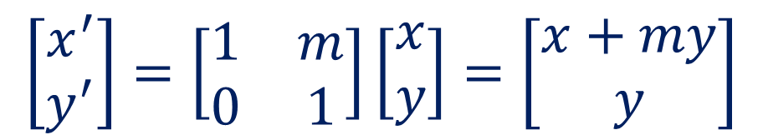

Shear
Horizontal Shear:
$$\left[\begin{matrix}x^{′} \\ y^{′}\end{matrix}\right]=\left[\begin{matrix}1 & m \\ 0 & 1\end{matrix}\right]\left[\begin{matrix}x \\ y\end{matrix}\right]=\left[\begin{matrix}x+my \\ y\end{matrix}\right]$$
Vertical Shear:
$$\left[\begin{matrix}x^{′} \\ y^{′}\end{matrix}\right]=\left[\begin{matrix}1 & 0 \\ m & 1\end{matrix}\right]\left[\begin{matrix}x \\ y\end{matrix}\right]=\left[\begin{matrix}x \\ mx+y\end{matrix}\right]$$

Slide 40

Identity Matrix
Identity (“do nothing”) matrix = unit scaling, no rotation!
$$\left[\begin{matrix}1 & 0 & 0 \\ 0 & 1 & 0 \\ 0 & 0 & 1\end{matrix}\right]\left[\begin{matrix}x \\ y \\ z\end{matrix}\right]=\left[\begin{matrix}x \\ y \\ z\end{matrix}\right]$$

Slide 41

Inverse of a Matrix
AI = IA = A
Inverse exists only for square matrices that are non-singular
Some matrices have an inverse, such that: AA⁻¹ = I
Inversion is tricky: (ABC)⁻¹ = C⁻¹B⁻¹A⁻¹
Derived from non-commutativity property
$$I=\left[\begin{matrix}1 & 0 & 0 \\ 0 & 1 & 0 \\ 0 & 0 & 1\end{matrix}\right]$$

Slide 42



Determinant & Trace of a Matrix
Used for inversion
If det(A) = 0, then A has no inverse
$$A^{−1}=\frac{1}{ad−bc}\left[\begin{matrix}d & −b \\ −c & a\end{matrix}\right]$$
Trace = sum of diagonal elements (a+d)= sum of eigenvalues
$$A=\left[\begin{matrix}a & b \\ c & d\end{matrix}\right]$$
$$\det\left(A\right)=ad−bc$$

Slide 43







Eigenvalues & Eigenvectors
Eigenvectors (for a square m×m matrix S)
$$S\vec{v}=λ\vec{v}$$
Example
(right) eigenvector
eigenvalue
$$\vec{v}εℝ^{m}≠\vec{0}$$
$$λεℝ$$
$$S\vec{v}$$
$$\vec{v}$$
$$λ\vec{v}$$

Slide 44

Eigenvalues & Eigenvectors
In the shear mapping the red arrow changes direction but the blue arrow does not. The blue arrow is an eigenvector of this shear mapping because it doesn’t change direction, and since in this example its length is unchanged its eigenvalue is 1.

Slide 45







Computation of Eigenvalues
$$S\vec{v}=λ\vec{v}$$
$⟹(S−λI)$ $\vec{v}=0$
First find the eigenvalues $λ$ and substitute $λ$ in the above equation to obtain
eigenvectors
$$For eigenvalues solve, det\left(S−λI\right)=0$$
Example:
$$A=\left[\begin{matrix}0 & 1 \\ −6 & 5\end{matrix}\right]$$
$$A−λI=\left[\begin{matrix}−λ & 1 \\ −6 & 5−λ\end{matrix}\right]$$
$det⁡\left(\left[\begin{matrix}−λ & 1 \\ −6 & 5−λ\end{matrix}\right]\right)$= $−λ(5−λ$)+6=($λ−2)\text{(}λ−3)$
$$Eigenvalues are 2, 3$$

Slide 46





Computation of Eigenvectors
$(S−λI)$ $\vec{v}=0$
$$\left[\begin{matrix}−λ & 1 \\ −6 & 5−λ\end{matrix}\right]\left[\begin{matrix}v_{1} \\ v_{2}\end{matrix}\right]=\left[\begin{matrix}0 \\ 0\end{matrix}\right]⇒\begin{matrix}{−λv}_{1}+v_{2}=0 \\ {−6v}_{1}+{(5−λ)v}_{2}=0\end{matrix}$$
$λ=2$:
$$⇒\begin{matrix}{−2v}_{1}+v_{2}=0 \\ {−6v}_{1}+{3v}_{2}=0\end{matrix}$$
Both are same
$⇒{2v}_{1}=v_{2}⇒$ $v_{1}=t, v_{2}=2t;t>0$
$$∴\vec{v}=\left[\begin{matrix}t \\ 2t\end{matrix}\right]is a eigenvector$$

Slide 47




Computation of Eigenvectors
$$\left[\begin{matrix}−λ & 1 \\ −6 & 5−λ\end{matrix}\right]\left[\begin{matrix}v_{1} \\ v_{2}\end{matrix}\right]=\left[\begin{matrix}0 \\ 0\end{matrix}\right]⇒\begin{matrix}{−λv}_{1}+v_{2}=0 \\ {−6v}_{1}+{(5−λ)v}_{2}=0\end{matrix}$$
$λ=3$:
$$⇒\begin{matrix}{−3v}_{1}+v_{2}=0 \\ {−6v}_{1}+{2v}_{2}=0\end{matrix}$$
$⇒{3v}_{1}=v_{2}⇒$ $v_{1}=t, v_{2}=3t;t>0$
$$∴\vec{v}=\left[\begin{matrix}t \\ 3t\end{matrix}\right]is another eigenvector$$

Slide 48

Singular Value Decomposition (SVD)
Handy mathematical technique that has application to many problems
Given any m×n matrix A, algorithm to find matrices U, V and W such that
  $$A_{m×n}=U_{m×n}W_{m×n}{V_{n×n}^{}}^{T}$$
  U and V are orthonormal
  W is n×n and diagonal

Slide 49
Singular Value Decomposition (SVD)
The columns of U are orthonormal eigenvectors of AA^{T}
The columns of V are orthonormal eigenvectors of A^{T}A,
S is a diagonal matrix containing the square roots of eigenvalues from U or V in descending order.

Slide 50
Singular Value Decomposition (SVD)
The w_{i} are called the singular/eigen values of A
If A is singular, some of the w_{i} will be 0
In general rank(A) = number of nonzero w_{i}
SVD is mostly unique.

Slide 51
For more details
Prof. Gilbert Strang’s course videos:
http://ocw.mit.edu/OcwWeb/Mathematics/18-06Spring-2005/VideoLectures/index.htm
Online Linear Algebra Tutorials:
http://tutorial.math.lamar.edu/AllBrowsers/2318/2318.asp

